Slide 1

ElectViz: Election Data Visualization for Media
Analyzing the 2019 Indian General Election dataset to create interactive dashboards for data-driven political analysis.
Presented By: Akshaya

Slide 2

Project Overview & Core Purpose
Real-World Experience
Media Support
Gained practical experience handling large public datasets and designing professional business dashboards.
Aimed to show how data-driven insights can support media coverage and political research.
Simplification
The core purpose was to make complex election information simple, visual, and meaningful for end-users.

Slide 3






Primary Objective: Dynamic Analysis
Identify Patterns
Track trends across candidates, parties, and states.
Design Dynamic Dashboard
A Power BI dashboard to analyze nationwide election results.
Support Transparency
Enable transparent and fact-based election interpretation.
Key insights presented included votes, education, gender, and financial background of candidates.

Slide 4
Technologies & Data Preparation
Technologies Used
Data Cleaning Steps
Microsoft Power BI
Removed duplicates & irrelevant rows.
Power Query
Standardized names and converted text to numeric formats.
DAX
Primary Source: Election Commission of India (Official public dataset in Excel/CSV format).
Cleaned asset/liability fields (₹ formatting).
Handled missing values and created structured tables.

Slide 5





Dataset Scope: Rich Candidate Details
The raw data provided comprehensive information, which was structured for analysis.
Candidate & Party
Details on affiliations and performance.
Assets & Liabilities
Financial background analysis.
Criminal Cases
Information on legal history.
Demographics
Gender, age, and education levels.

Slide 6
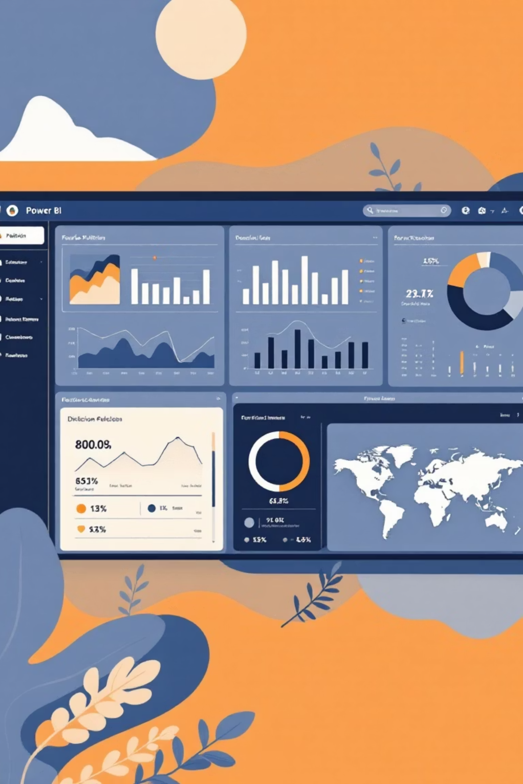

Dashboard Features: Key Visuals
The ElectViz dashboard incorporated diverse visuals to present complex data clearly.
Performance Tracking
Party performance charts and KPI Metrics summary.
Geographic View
State-wise map visual for regional results.
Demographic Distribution
Gender and category-wise distribution of winners.
Correlation Analysis
Scatter analysis of Assets vs. Criminal Cases.

Slide 7
Key Insights from the Data
Gender Disparity
Majority of election winners were male candidates.
Education & Wealth
Higher education and greater wealth correlated with a significantly better win ratio.
Party Dominance
BJP performed strongest nationwide, securing the most winners.
Criminal Charges
Analysis showed that some candidates with criminal charges successfully won elections.

Slide 8
Challenges and Resolutions
Challenge
Resolution
Inconsistent raw data
Data cleaning and formatting in Excel & Power Query.
Complex relationship model
Built structured star schema for data modeling.
DAX formula complexity
Used modular and simplified DAX calculations.
Too much data for visuals
Applied a clean, minimal BI design approach.

Slide 9



Internship Learnings & Future Scope
Technical Skills Gained
Future Scope
Power BI dashboard creation & KPI techniques
Integrate real-time election data via API.
Data modeling & advanced DAX measures
Data cleaning with Power Query
Real-time problem solving on datasets
This project strengthened practical BI knowledge and boosted confidence in real-world analytics.
Add ML model for result prediction.
Develop web-based and mobile-view BI dashboards.

Slide 10


Conclusion: A Powerful Analysis Tool
The ElectViz dashboard serves as a transparent and powerful election analysis tool for journalists, analysts, and the public.
Thank You

